Slide 1

Gift Exchange Organizer
Storyboard

Slide 2
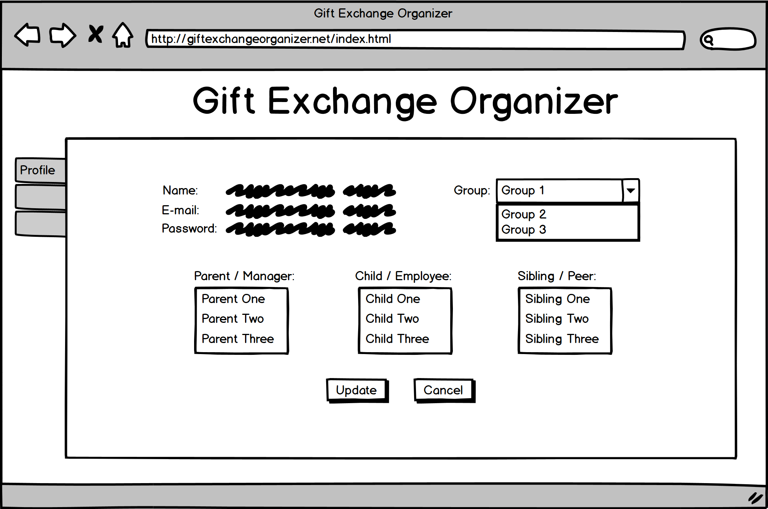

Profile Setup
The Grandma Type would like to set up her profile. She does this by:
Clicking the “Profile” tab (if not already selected)
Updating the “Password”, “Name” or “Group” fields if required (the “E-mail” field is not editable)
Entering “Parent / Manager”, “Child / Employee” and “Sibling / Peer” data as applicable
Clicking the “Update” button

Slide 3
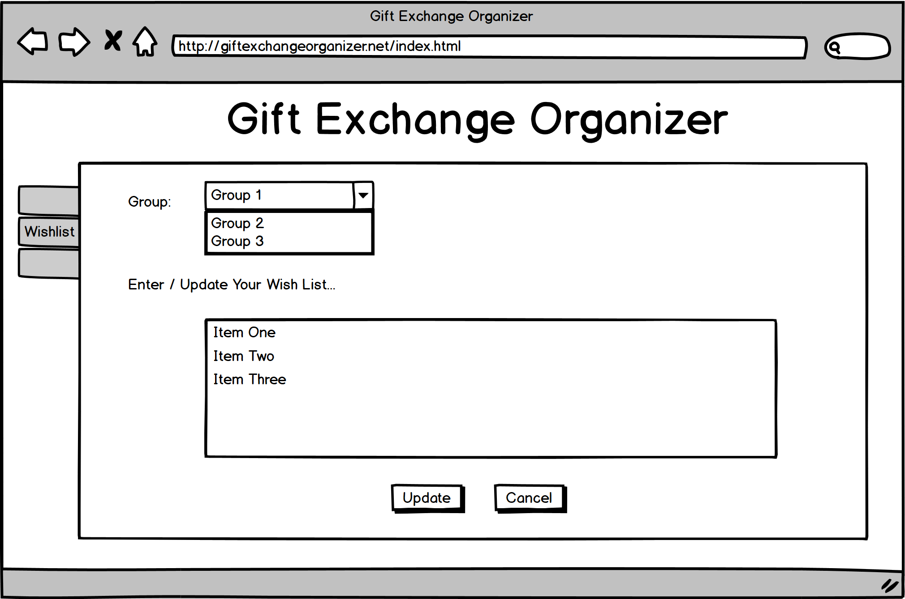
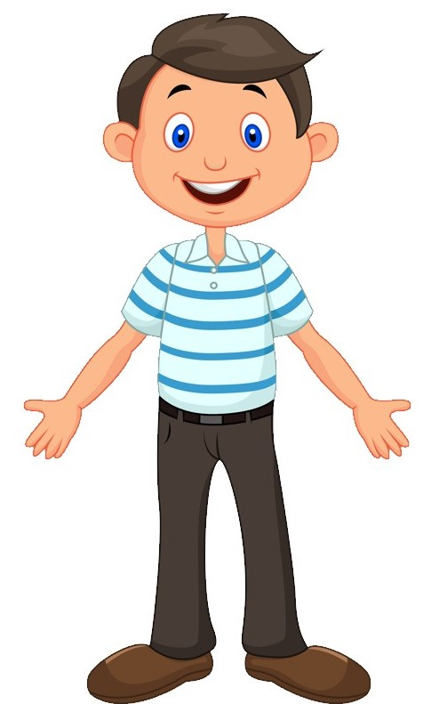
Wish List Setup
The BrotherType would like to set up his wish list for both work and family events. He does this by:
Clicking the “Wishlist” tab (if not already selected)
Selecting the Group for which he would like to update his wishlist
Entering URLs, item names, descriptions, or any other text in the list
Clicking the “Update” button
Repeating the above steps for each group

Slide 4
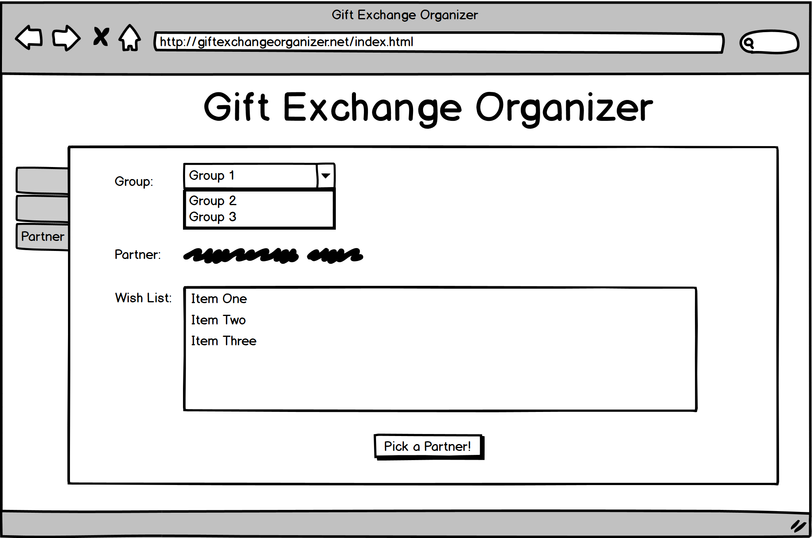
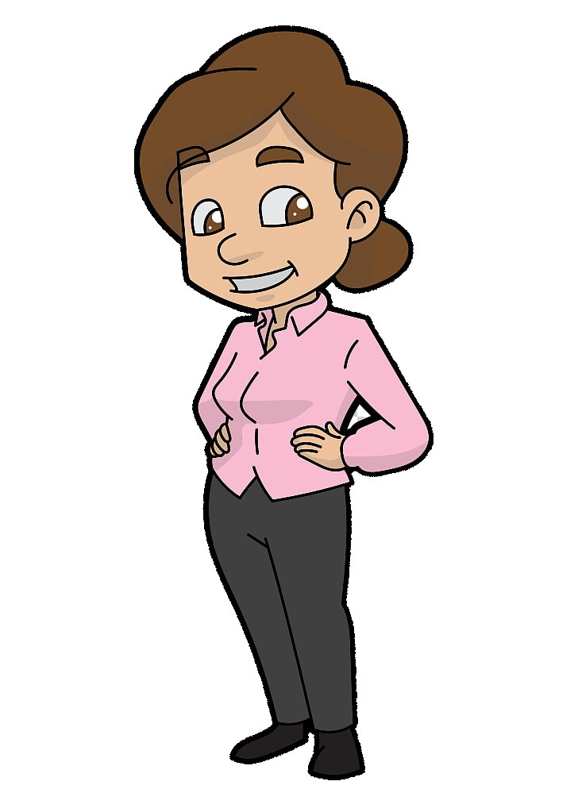
Name Drawing
The Mom Type would like to draw a name and print the wish list. She does this by:
Clicking the “Partner” tab (if not already selected)
Selecting a “Group” in the drop-down list
Clicking the “Pick a Partner!” button

Slide 5
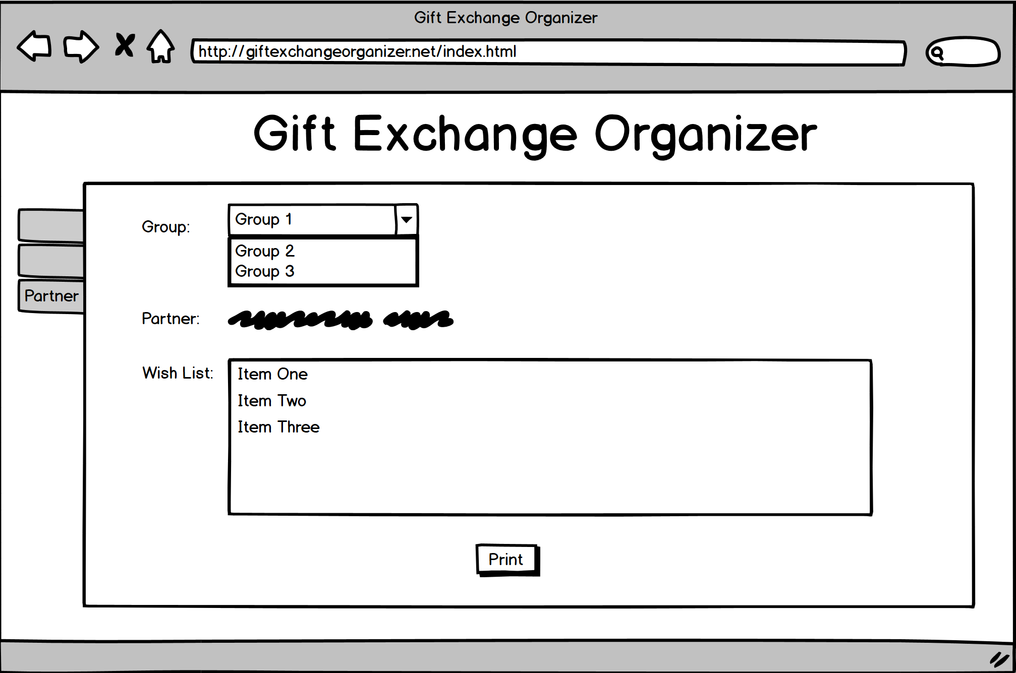
Name Drawing
Clicking the “Pick a Partner!” button automatically chooses an appropriate name from the list of users and displays that person’s wish list.
Clicking the “Print” button prints the wish list for offline use.

Slide 6
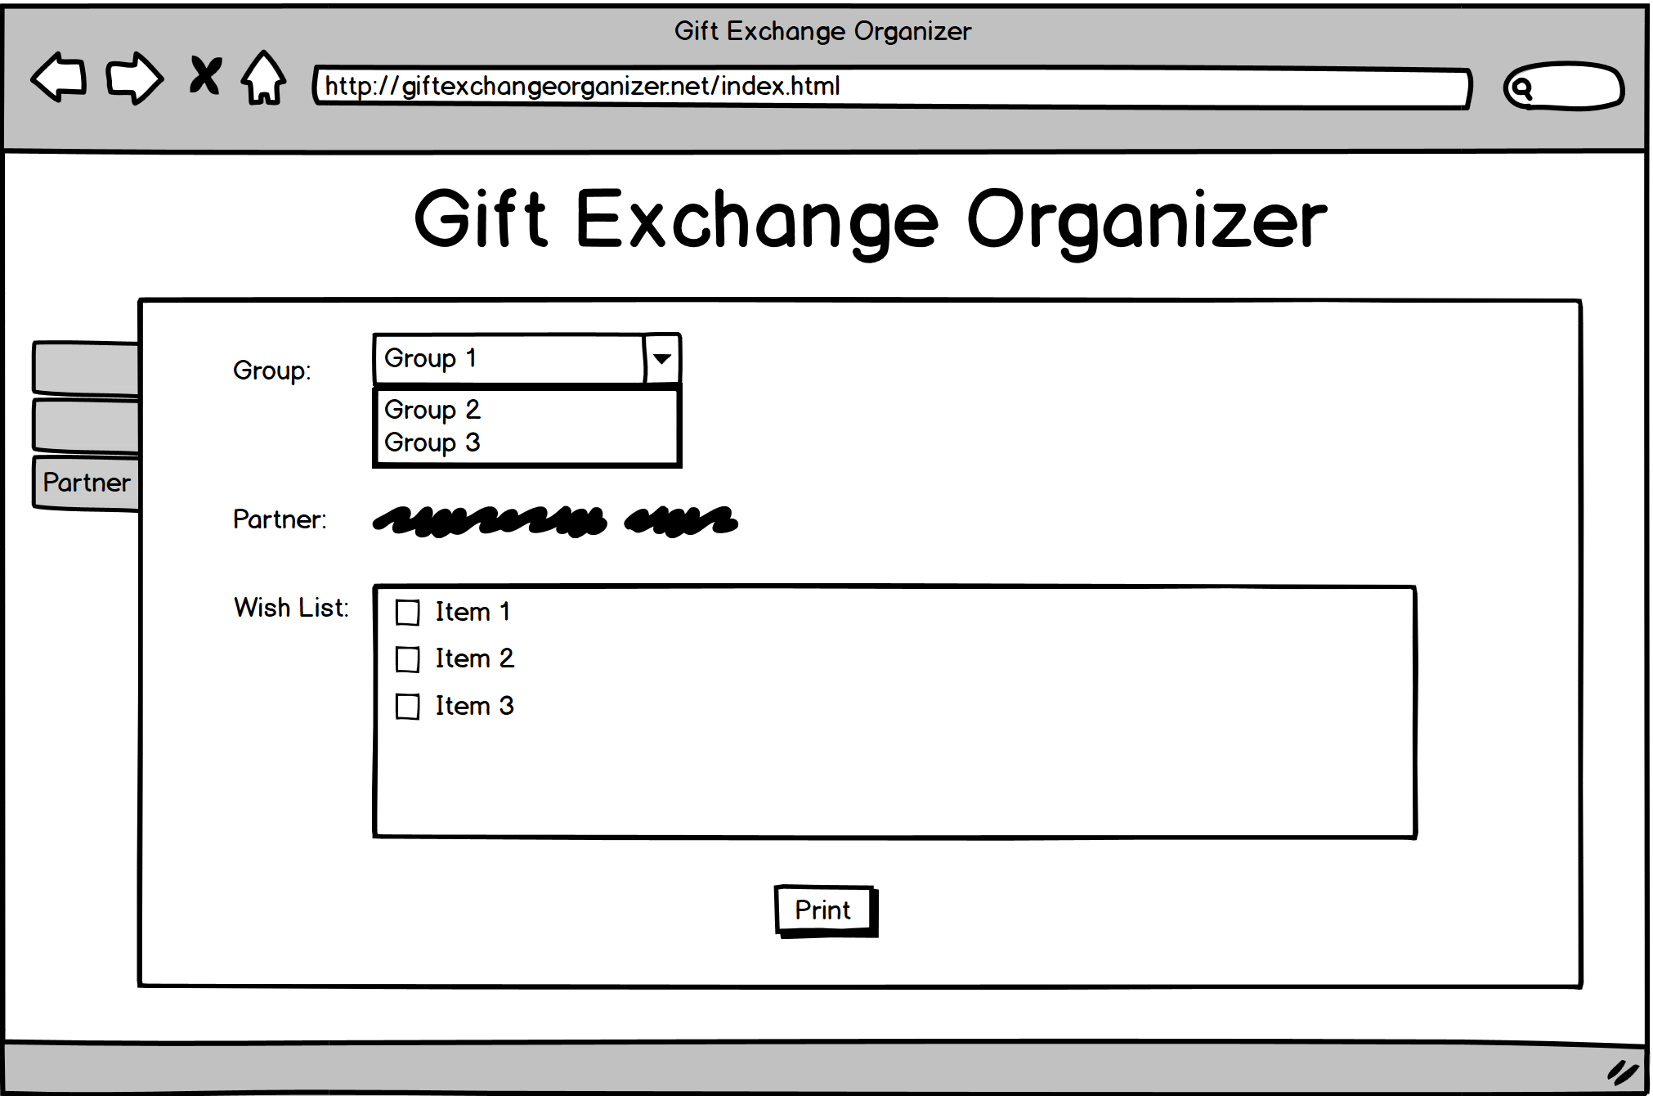
Stretch Feature
The Mom Type would like to mark an item as purchased. She does this by:
Clicking the “Partner” tab (if not already selected)
Selecting a “Group” in the drop-down list
Locating the item in the list and checking the box

